Slide 1



Climate change information for impact and adaptation for Africa: state-of-the-art and gaps
Dr. Mouhamadou Bamba SYLLA (sylla.bamba@aims.ac.rw)
Research chair, African Institute for Mathematical Sciences (AIMS) - Rwanda
Lead Author of IPCC AR6, WG1: Chapter 12
Contributing Author to IPCC AR6, WG1: Chapter 11 and Atlas
Contributing Author to IPCC AR6 WG2: Chapter 9
Contributing Author to the IPCC SR1.5: Chapter 3

Slide 2
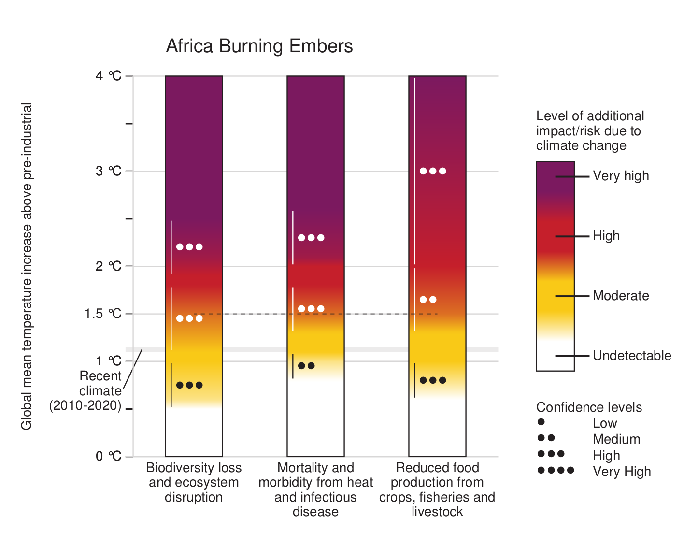
I/ The Context
Africa:
Climate change hot spot where increased hazards probability, vulnerability and exposure meet: climate risk is high
Recent studies (i.e. IPCC AR6 SR1.5):
Risk increases with respect to global warming level
At 4ºC, all risks are are equal and very high
Tackling climate change for a resilient development in Africa
IPCC WG2, 2022

Slide 3
I/ The Context …
Thorough understanding, robust information relevant for the sectors
Climate
(variability, weather, extremes, hazards)
Adapt, Mitigate, Plan or Action
Sectors
(agriculture, water resources, health, etc.)
Parameters
(crop yields, water availability, energy consumption, flows, etc.)
Most stakeholders’ interests
Disasters
Robust climate change information

Slide 4
II/ Climate Change Information
Climate change information VS adaptation
Transformational
Adaptation
Changes for dealing with the more severe impacts of climate change further in the future
Major changes to social-ecological systems
Relocating entire populations
Changing land-use patterns
Medium-term adaptations, which deal with near-term climate change
Systems Adaptation
Climate change ready crops
Climate sensitive precision agriculture
Diversification and risk management
Short-term adaptations which enable better coping with current climate variability
Incremental
Adaptation
Cultivar, varieties, planting date
Water, nutrient and canopy management
Tilage
Climate Change

Slide 5
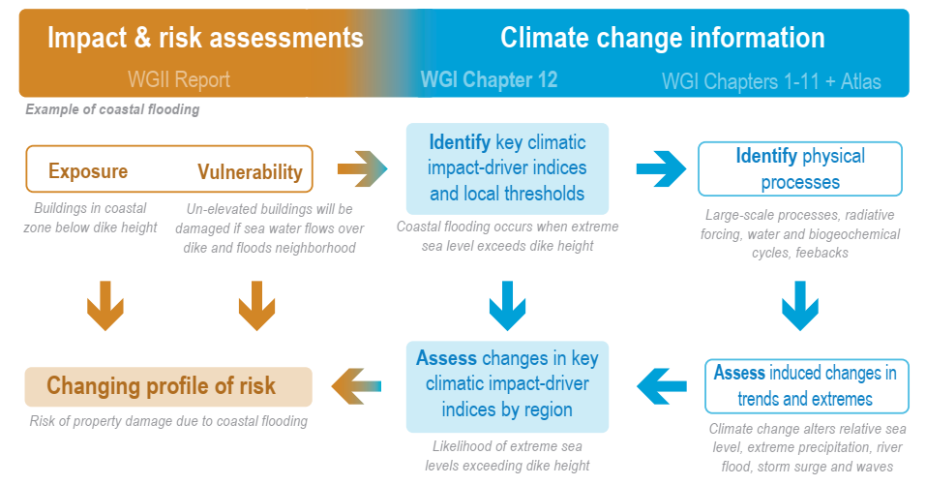
II/ Climate Change Information
Climate change Information in IPCC Risk Assessment Framework
IPCC WG1, 2021
A bunch of climate change information indices have been developed, most which are based on a tolerance threshold exceedance

Slide 6
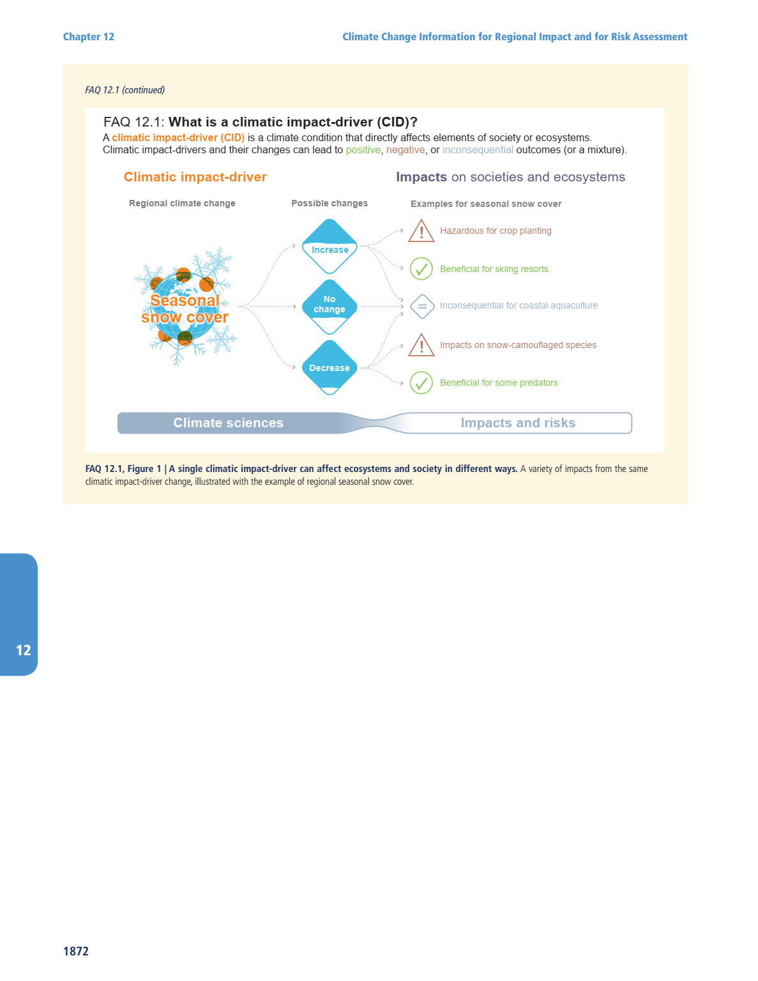
II/ Climate Change Information
Climatic Impact-drivers (CID)
CID is a climate condition that directly affects elements of society or ecosystems
CIDs and their changes can lead to positive, negative or inconsequential outcomes (or a mixture)
IPCC WG1 2021

Slide 7
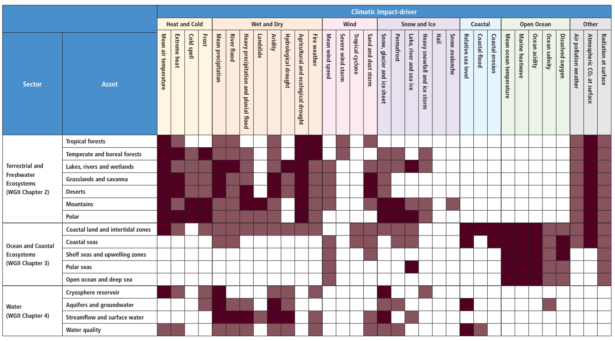
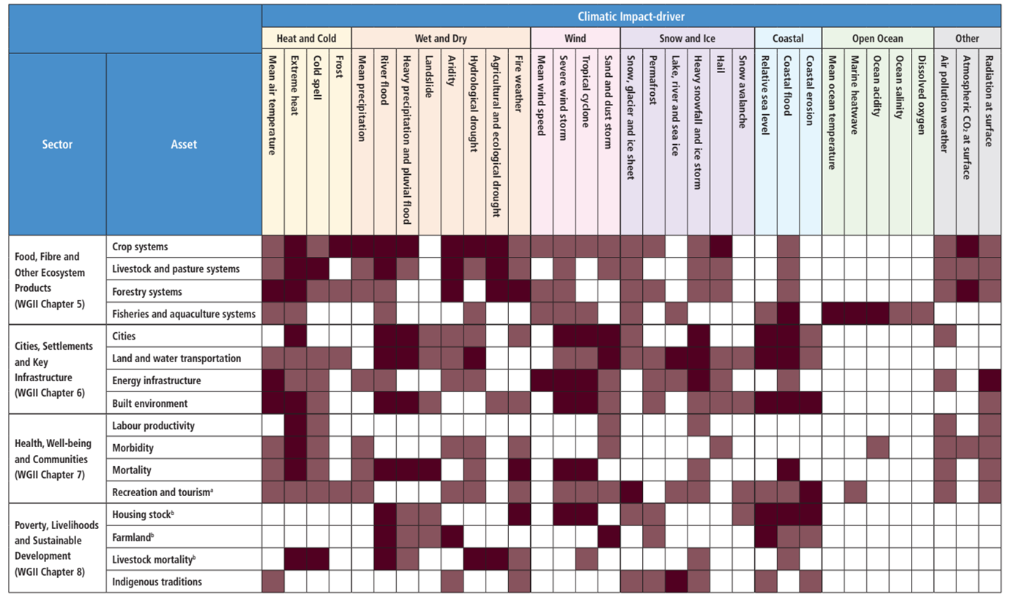
II/ Climate Change Information
Climatic Impact-drivers (CID)
CID is a climate condition that directly affects elements of society or ecosystems
CIDs and their changes can lead to positive, negative or inconsequential outcomes (or a mixture)
Each CID is relevant for one or many sectors/assets
IPCC WG1, 2021

Slide 8
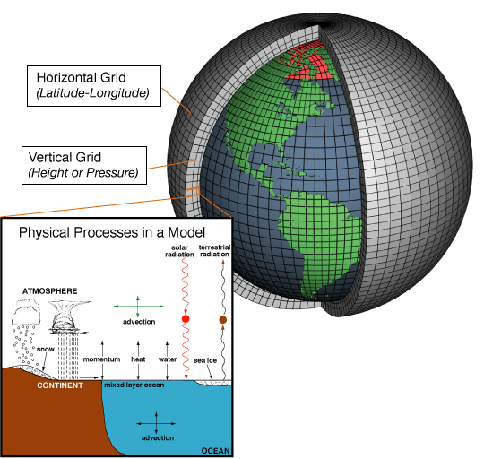
III/ Tools: Climate Models
Climate models are systems of differential equations based on the basic laws of physics, fluid motion, and chemistry.
They characterize how energy and matter interact to drive the different components of the Earth’s climate system: the atmosphere, oceans, biosphere, and land and ice-covered regions of the planet
Schematic of Climate Models

Slide 9
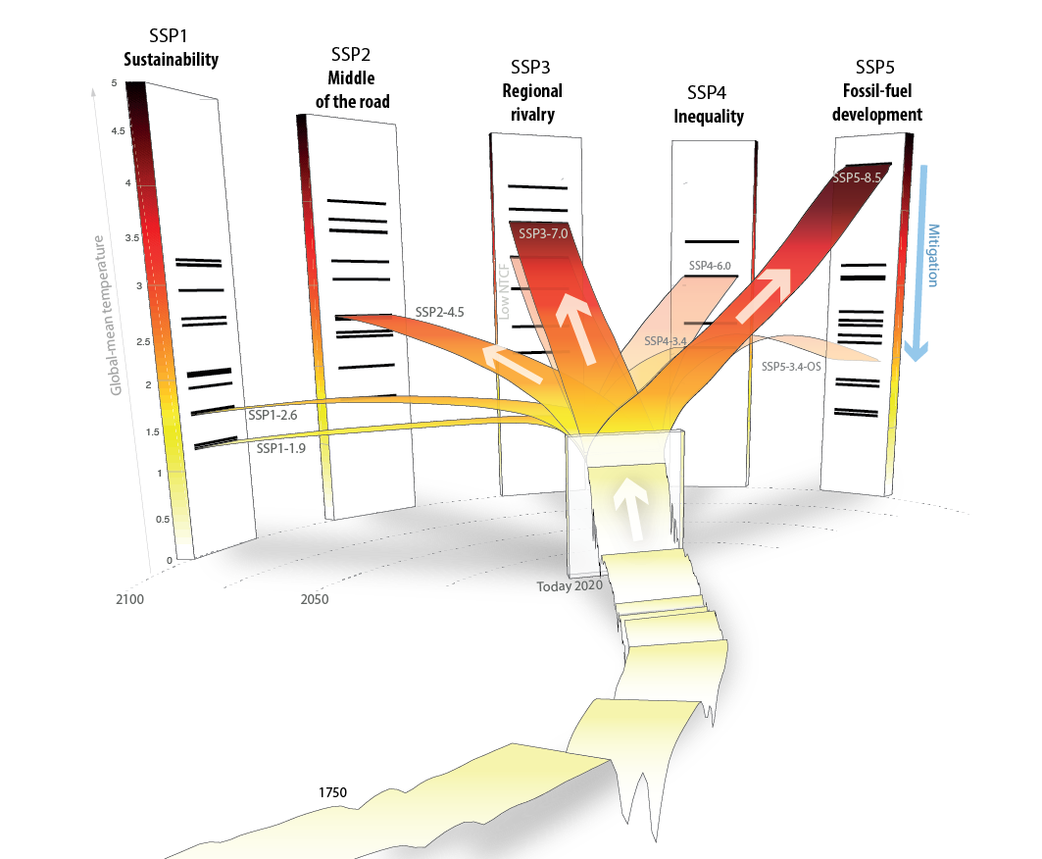
III/ Tools: Climate Models
- The five socio-economic SSP families
- Branches of the respective scenarios along the different socio-economic SSP families

Slide 10
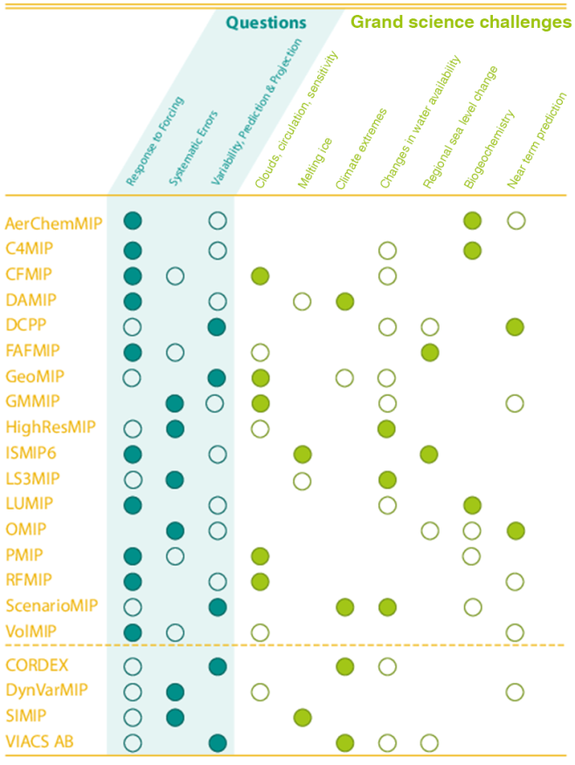
III/ Tools: Climate Models
CMIP6: GCMs and ESMs
For climate change studies: Historical, ScenarioMIP, HighResMIP
More than 30 GCMs/ESMs have made available daily data
SSP1-2.6; SSP2-4.5; SSP5-8.5
CORDEX: RCMs
For climate change studies: Evaluation, Historical and Projections – Downscaling CMIP5
More than 20 RCMs experiments available
RCP4.5, RCP8.5
CORDEX2: Downscaling CMIP6?

Slide 11
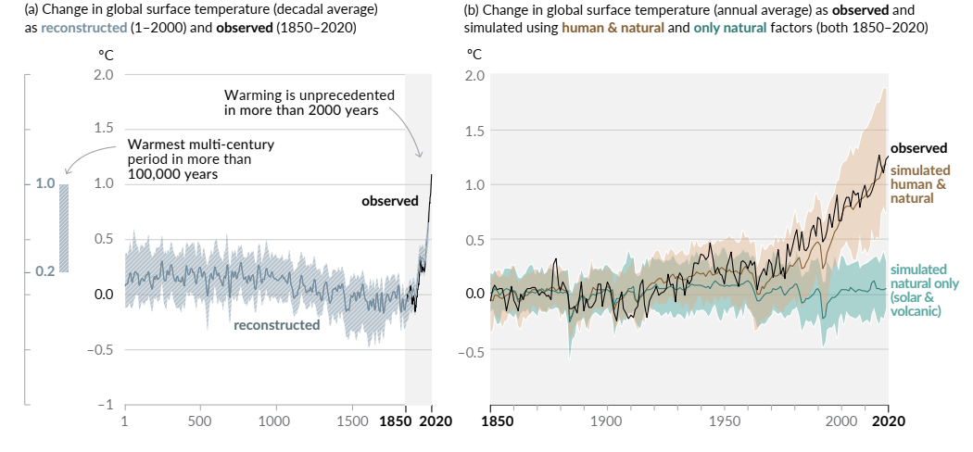
III/ State-of-the-Art
Climate change vs Global warming
IPCC WG1, 2021
Human influence has warmed the climate at a rate that is unprecedented in at least the last 2000 years

Slide 12
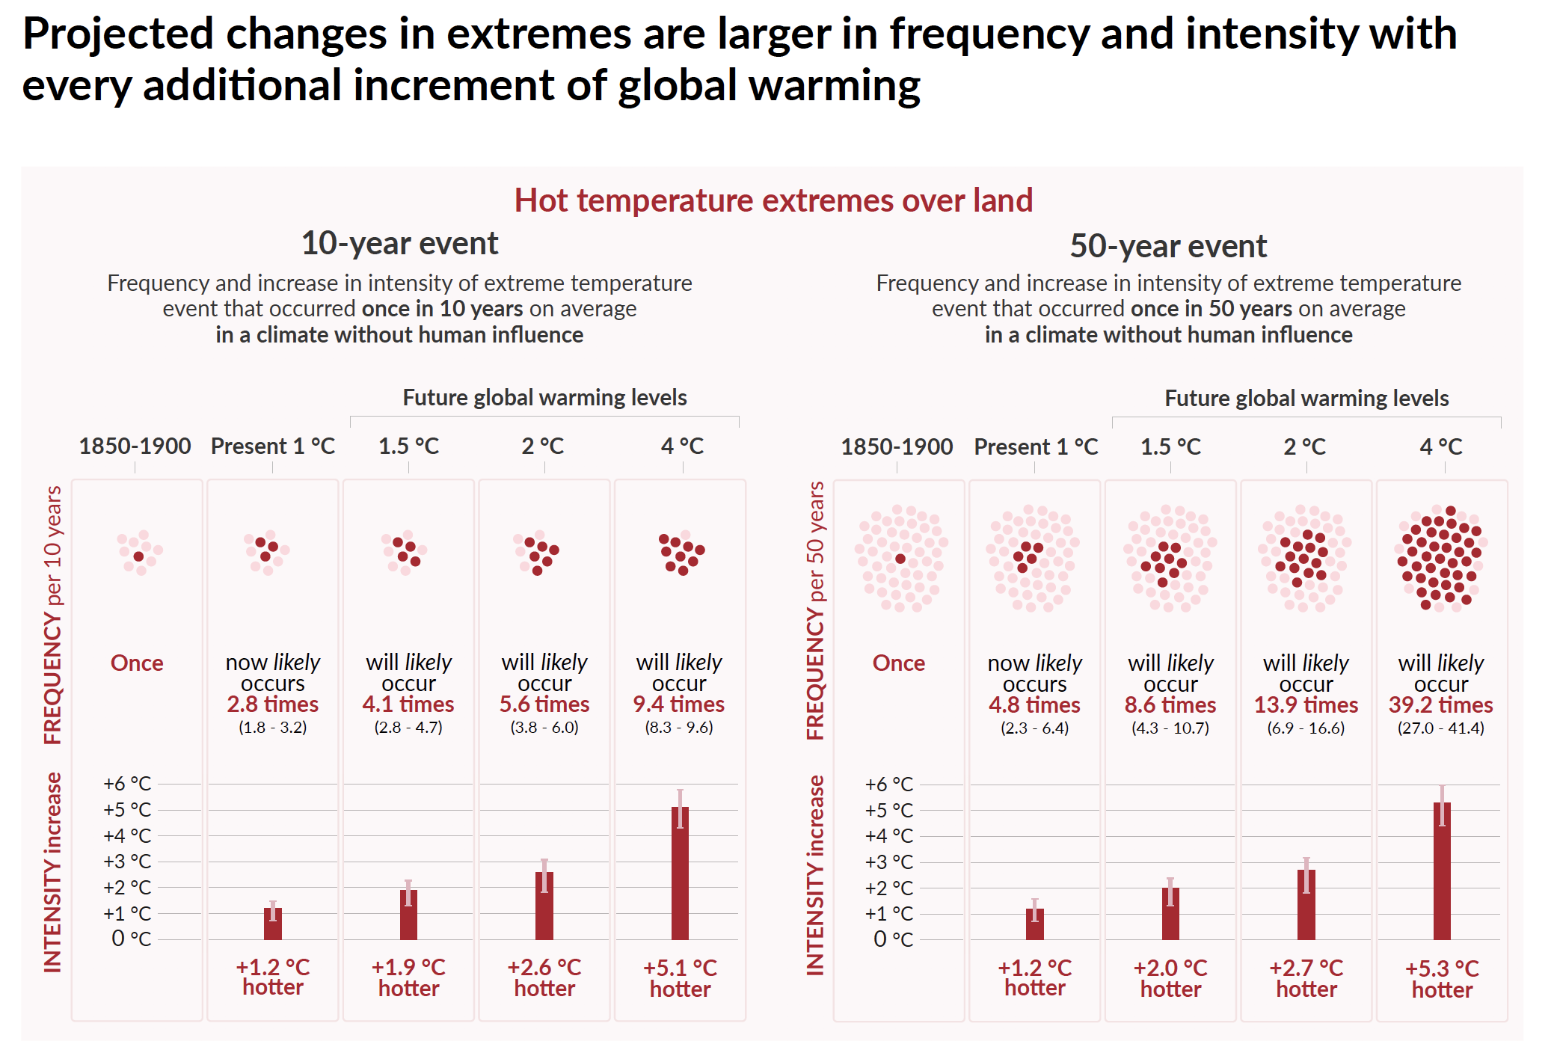
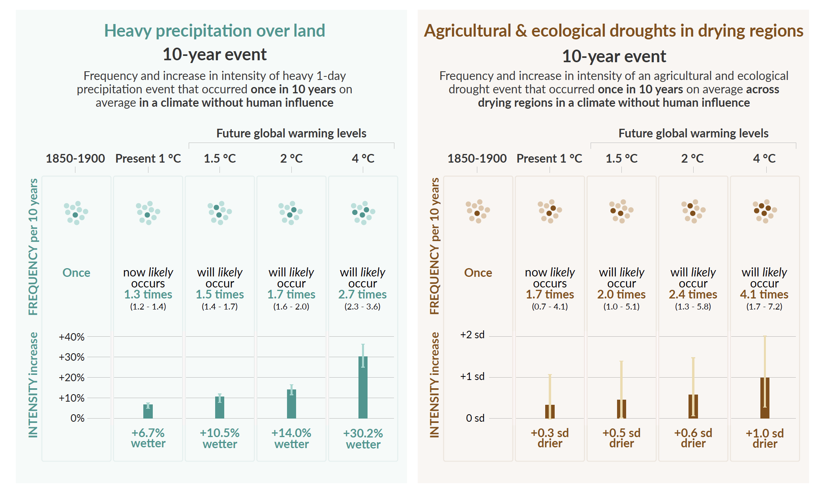
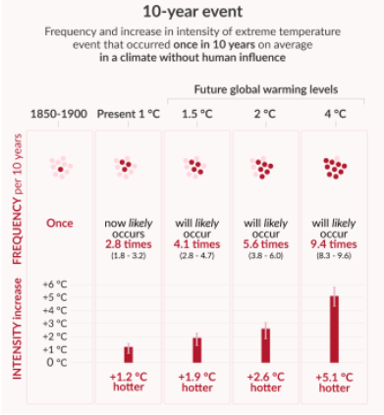
III/ State-of-the-art
+CAR
Every additional 0.5°C of global warming causes clearly discernible increases (high confidence)
IPCC WG1, 2021
Notes:
When we look quantitatively we at a global scale (these changes can be a lot larger at local scale). We see now at the current levels of warming (~1.09ºC) the 10year return event of heavy precipitation are ~7% wetter that it would have been without climate change and 10year drought events is drier that it would have been without climate change. These changes will become substantially larger with increases in global warming levels as you can see here in the figure for example at 1.5ºC (10% wetter) and at 4 (30% wetter). Same also for droughts.

Slide 13
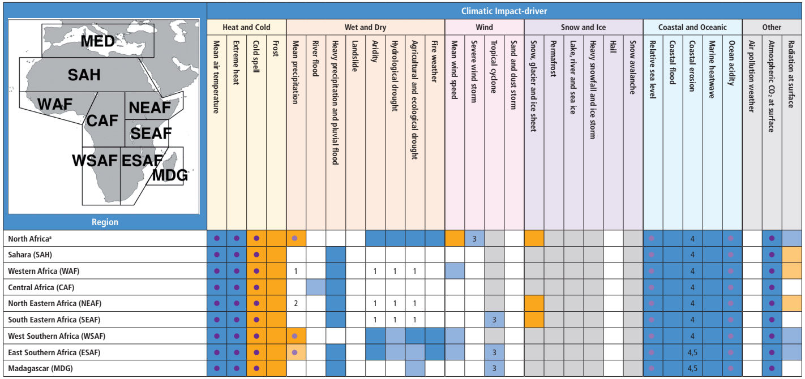
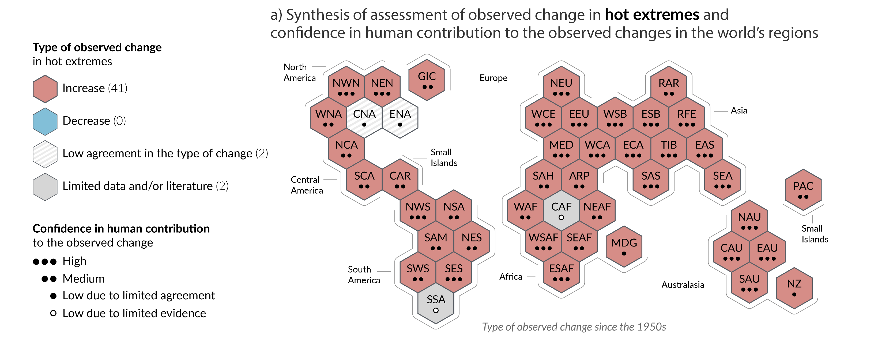
III/ State-of-the-Art
Extreme heat
Climate change is already affecting every inhabited region across the globe, with human influence contributing to many observed changes in weather and climate extremes

Slide 14
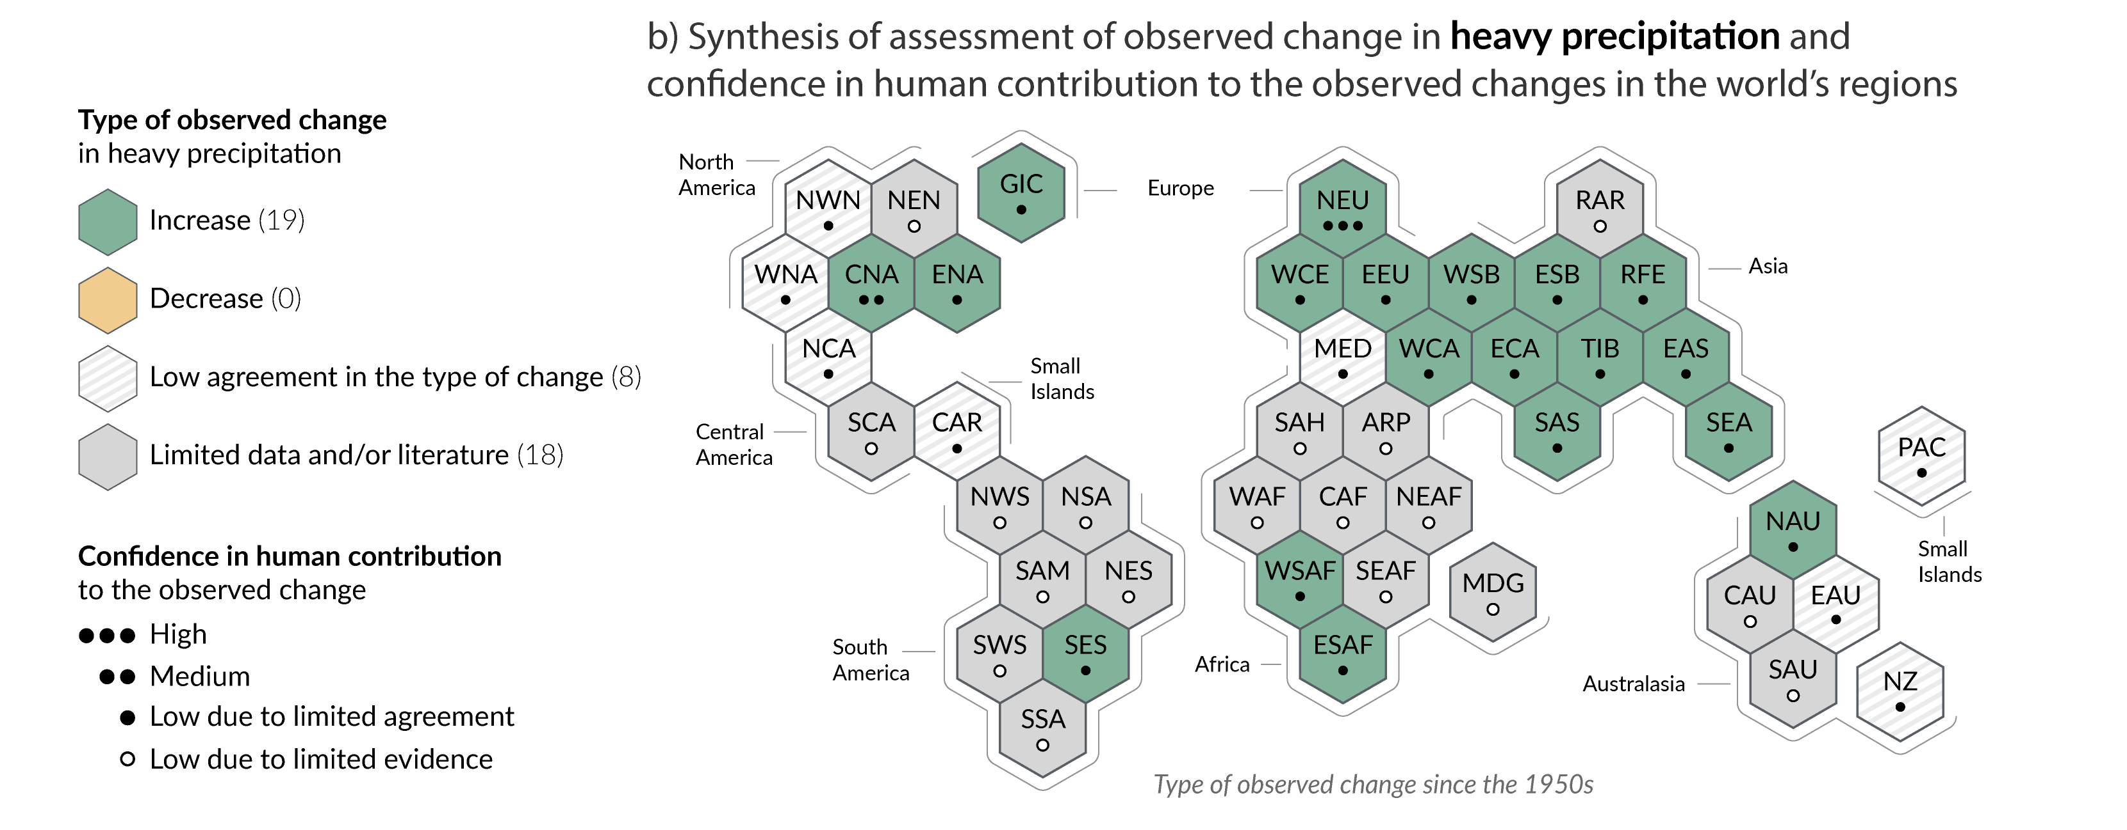
III/ State-of-the-Art
Heavy precipitation that can lead to floods
Climate change is already affecting every inhabited region across the globe, with human influence contributing to many observed changes in weather and climate extremes

Slide 15
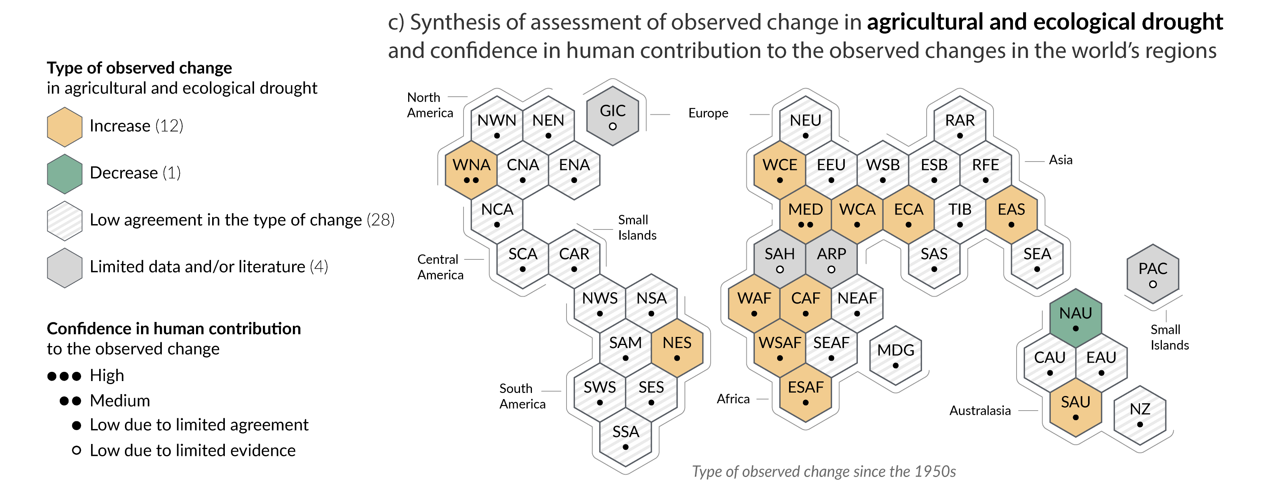
III/ State-of-the-Art
Drought
Climate change is already affecting every inhabited region across the globe, with human influence contributing to many observed changes in weather and climate extremes

Slide 16
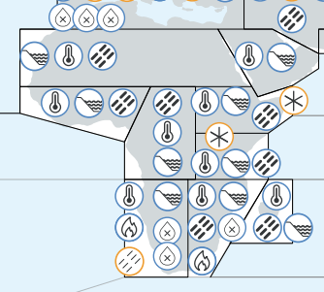
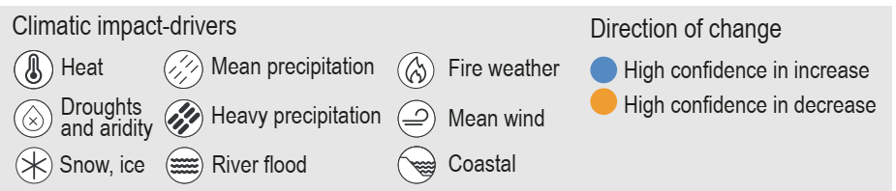
III/ State-of-art
Multiple climatic impact-drivers are projected to change in all regions of the world, especially in Africa
Most common changes: Heat, Coastal and Heavy Precipitation
Southern Africa: Drought and Fire Weather are added
Eastern Africa: Decreased Snow/Ice coverage emerges are added
IPCC WG1, 2021

Slide 17
IV/ Some Gaps
Link extreme heat indices to human, animal and plant health
Populate the African literature with more heat indices – increase the level of confidence !
Population and ecosystems exposure and how heat impacts work productivity and energy demand – quantification !
Energy demand is completely missing from CIDs – Yet very critical for Africa – Just transition
Literature related to drought issues in Africa has a lot of gaps. Rather than taking a general trend and averaging over a large domain, needs to disentangle spatially and temporally – change narrative

Slide 18
IV/ Some Gaps
Aridity is completely in the low confidence side – Need to look into biomes exposure
No attempts to link extreme precipitation to floods – large a large gaps about flood drivers in present-day and occurrence in the future
Landslides, River flooding, Fire weather, Windstorm, Dust and Sandstorm, Tropical cyclones
Invest more in the behavior of these CIDs under global warming of 1.5C, 2C, 2.5C, 3C, etc. – to inform AGN, risks and adaptation communities, policymakers,

Slide 19
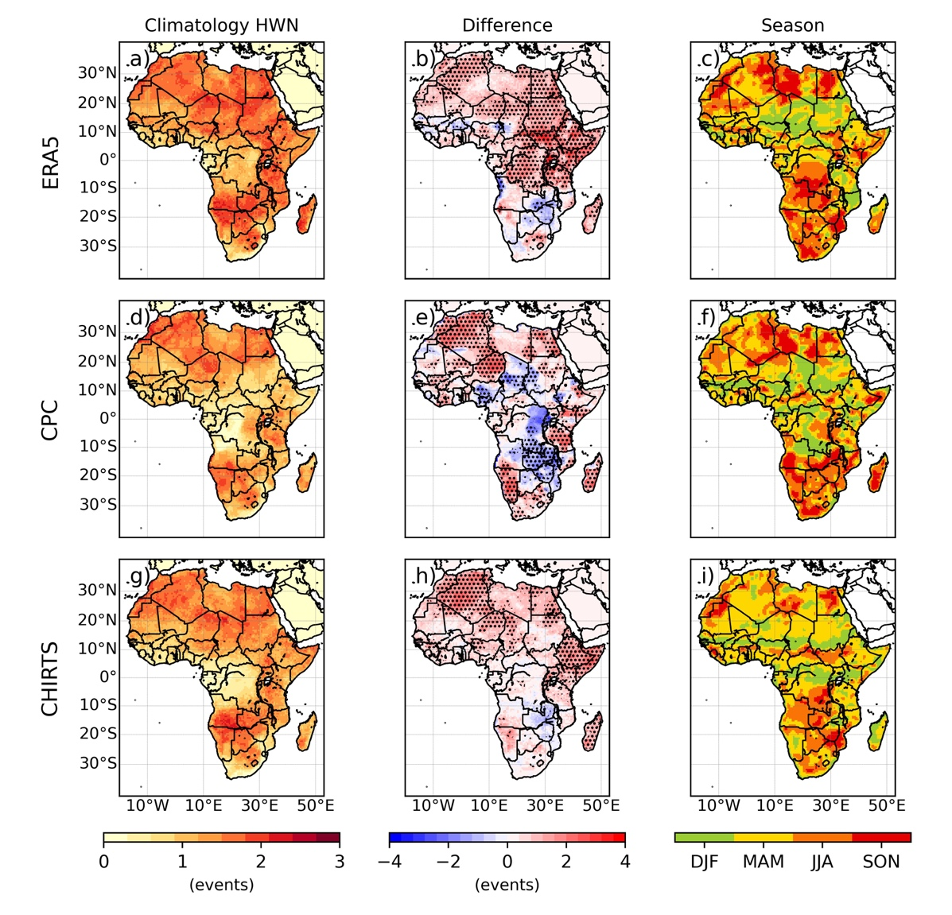
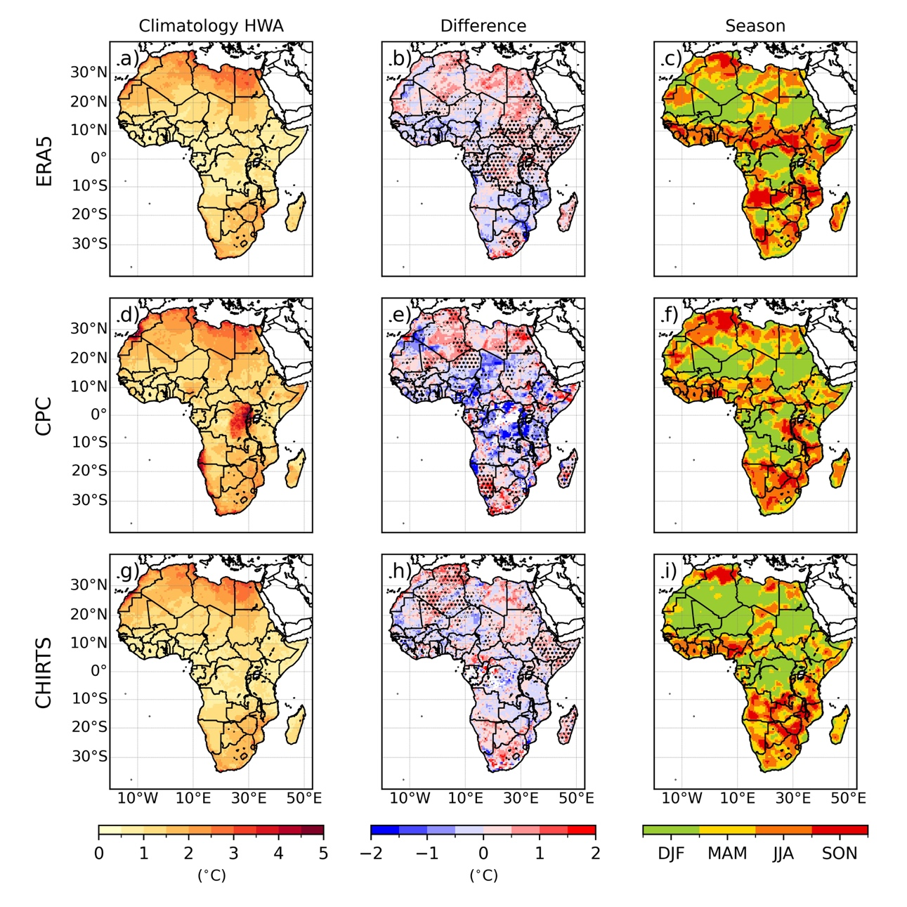
V/ Some gaps filled
Extreme Heat: observed heatwaves
Dajuma et al. 2023, under review

Slide 20
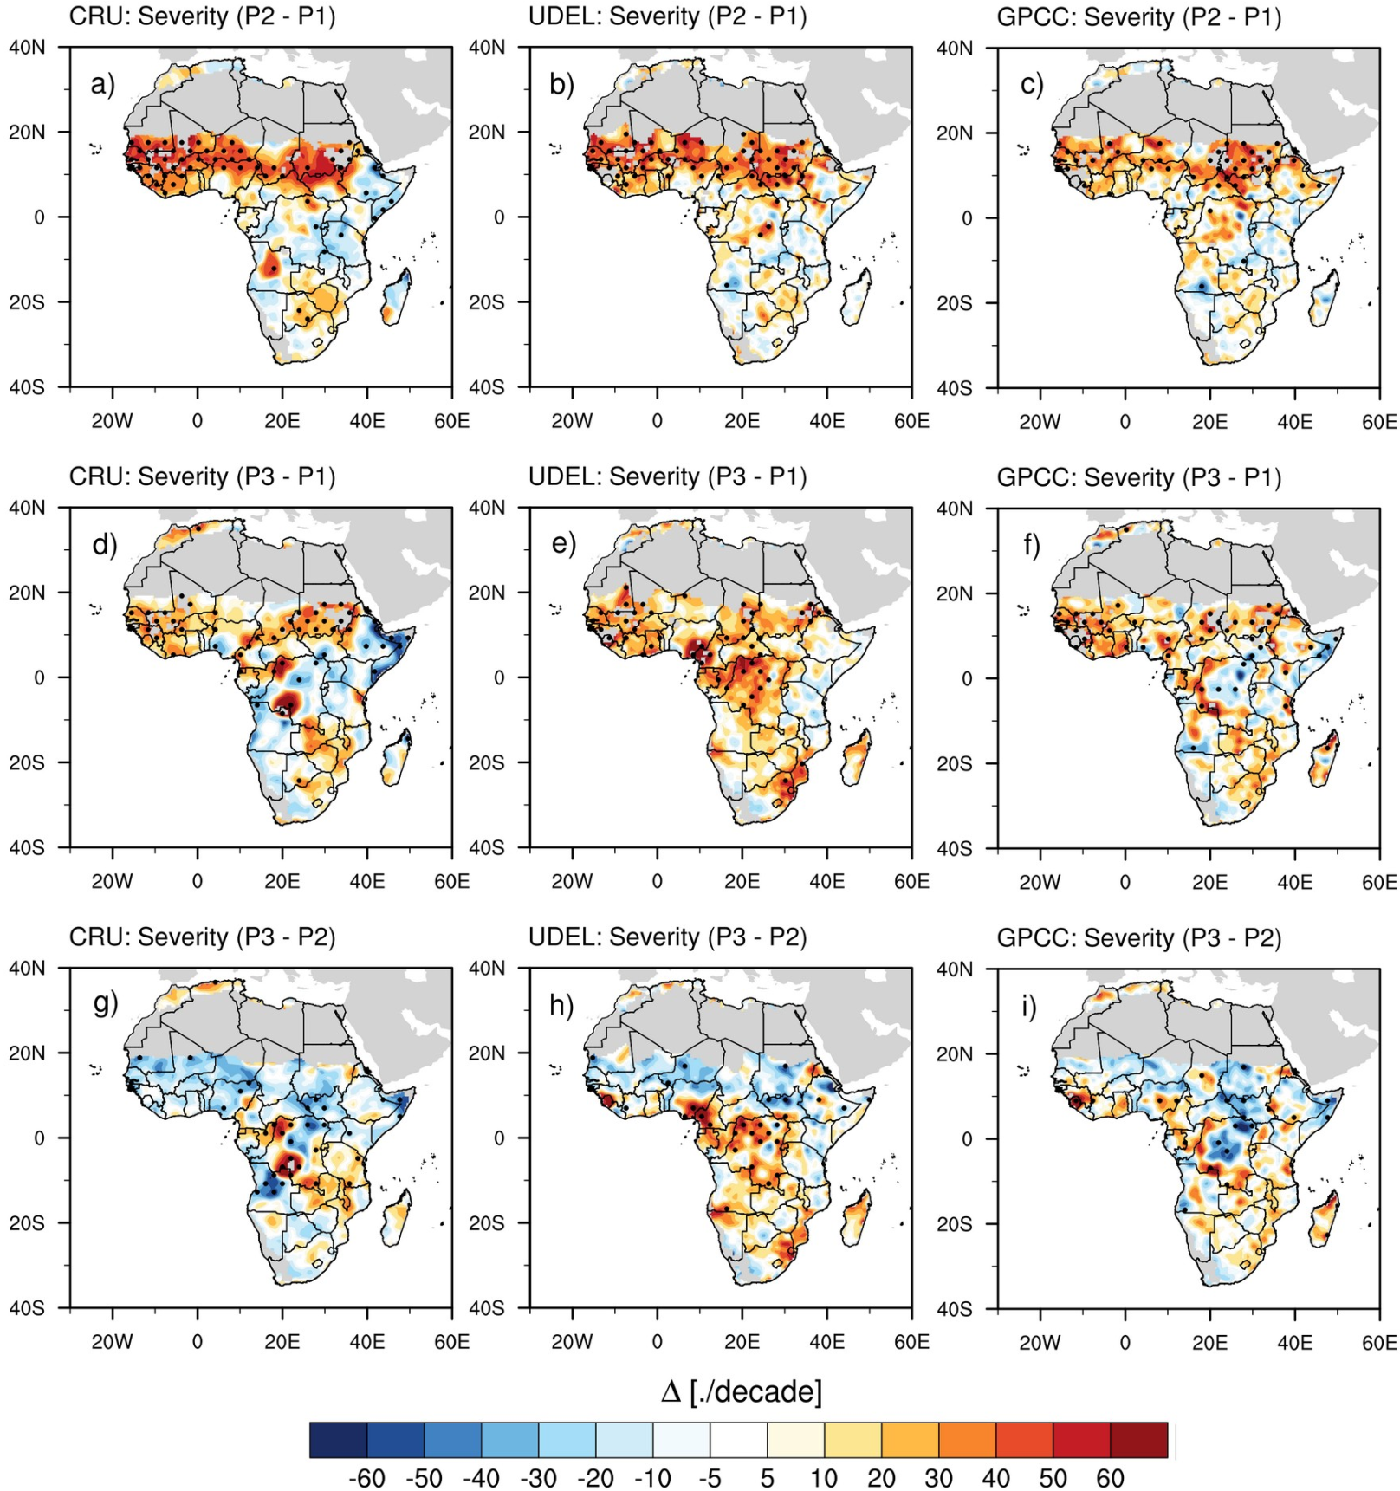
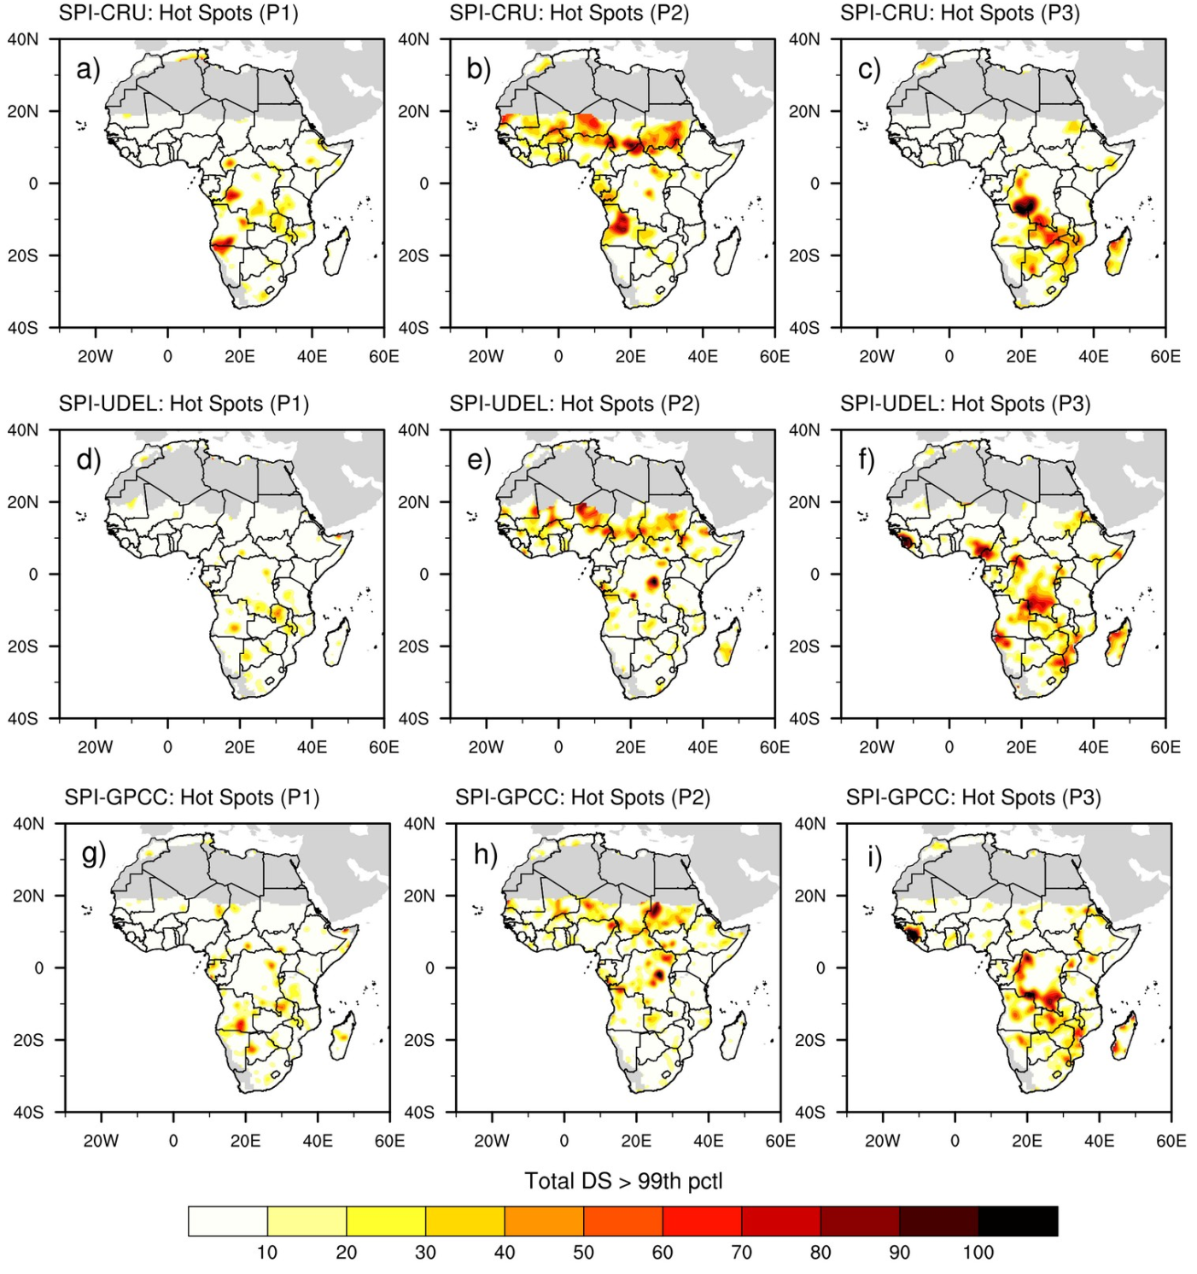
V/ Some gaps filled
Drought: Observed hotspots
- Drought changes: Duration, Frequency and Severity
Tall et al. 2023, IJOC
P1: 1928-1957
P2: 1958-1987
P3: 1987-2017

Slide 21
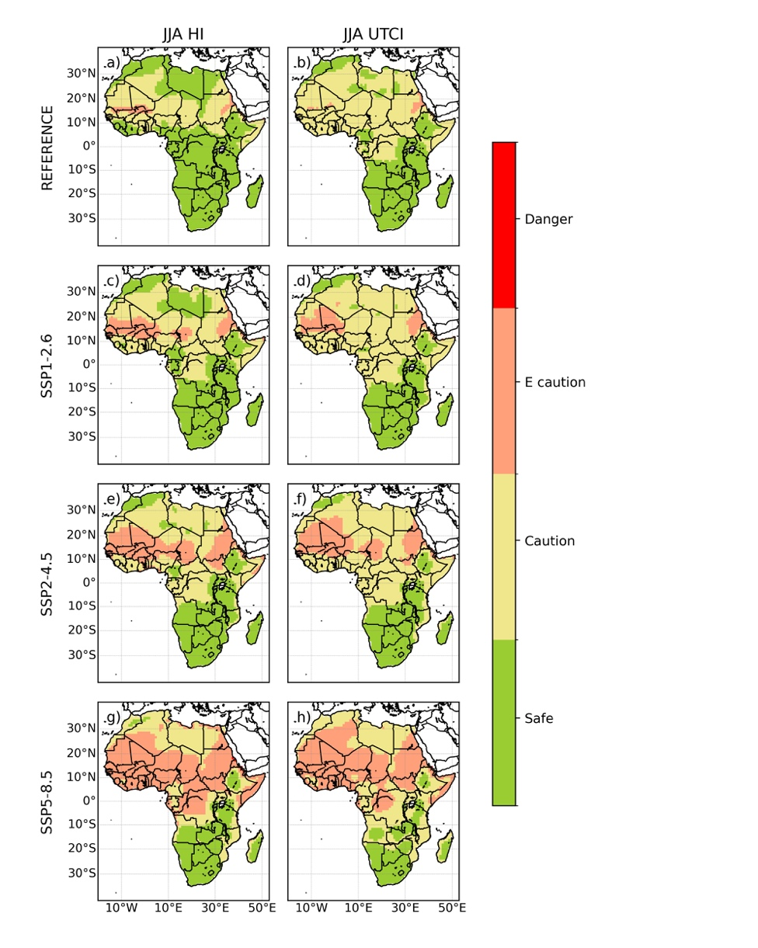
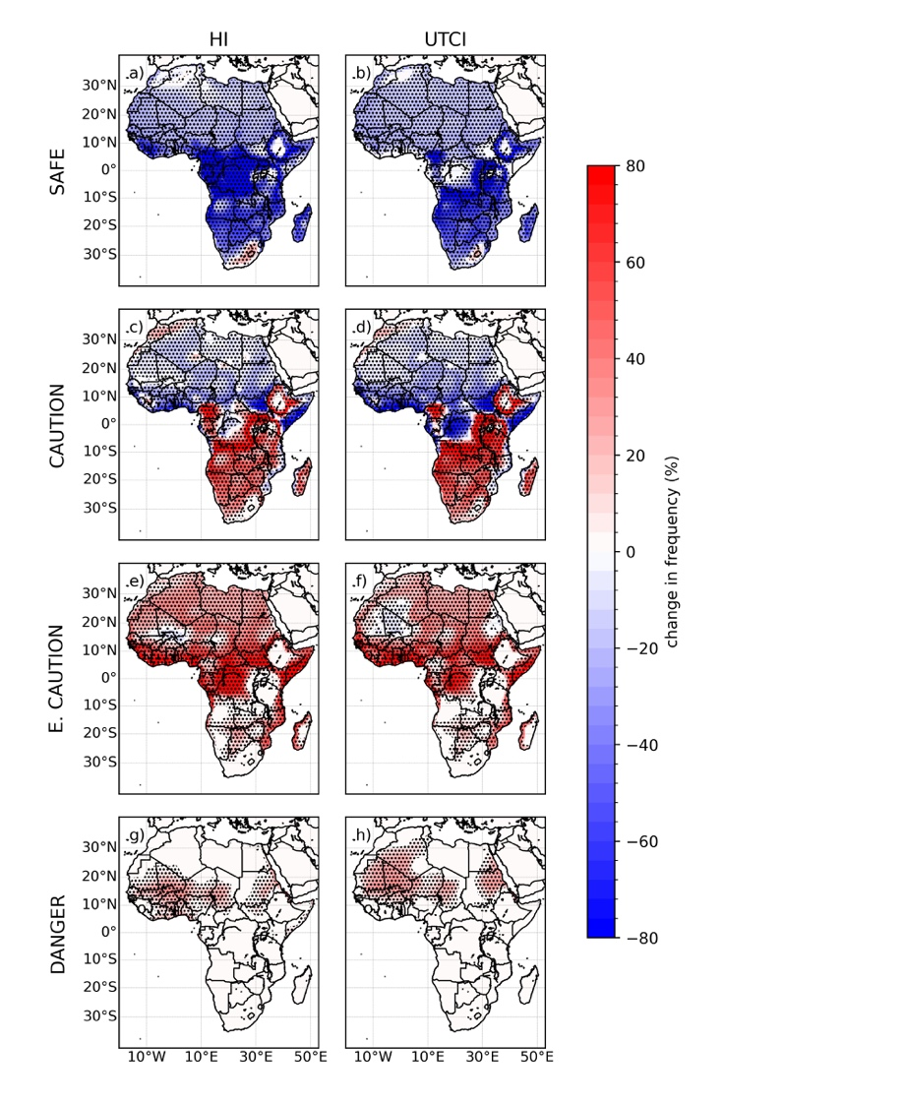
V/ Some gaps filled
Extreme Heat: Projected change of heat stress
Dajuma et al. 2023, Submitted

Slide 22
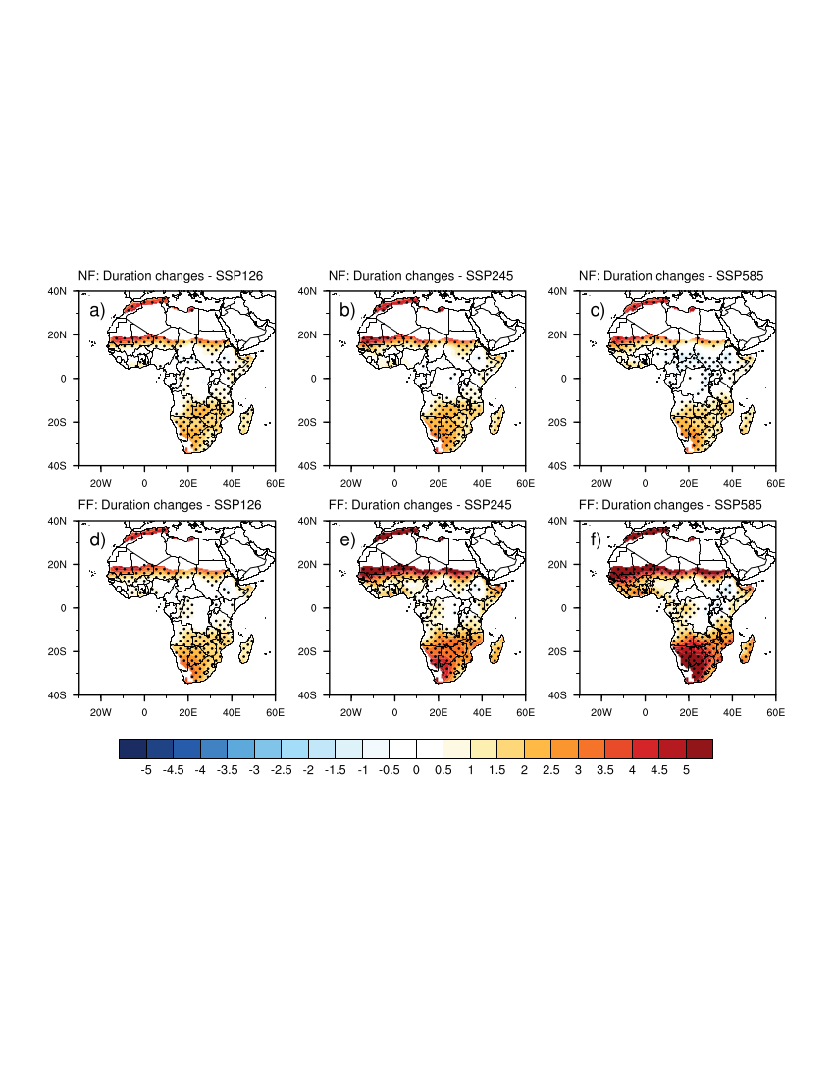
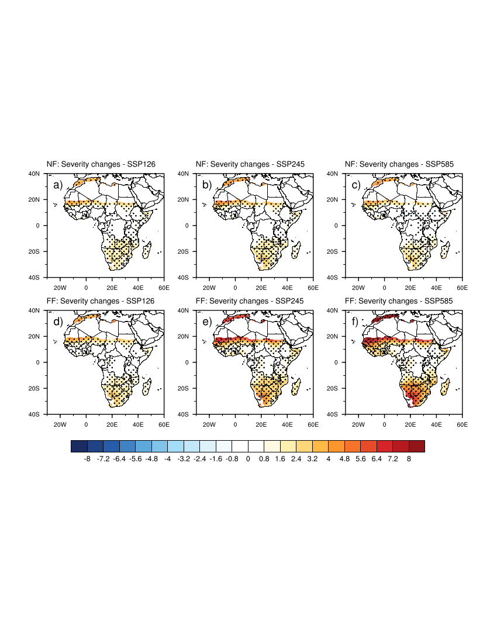
V/ Some gaps filled
Drought: Projected changes in frequency, severity, etc.
Tall et al. 2023, Submitted

Slide 23
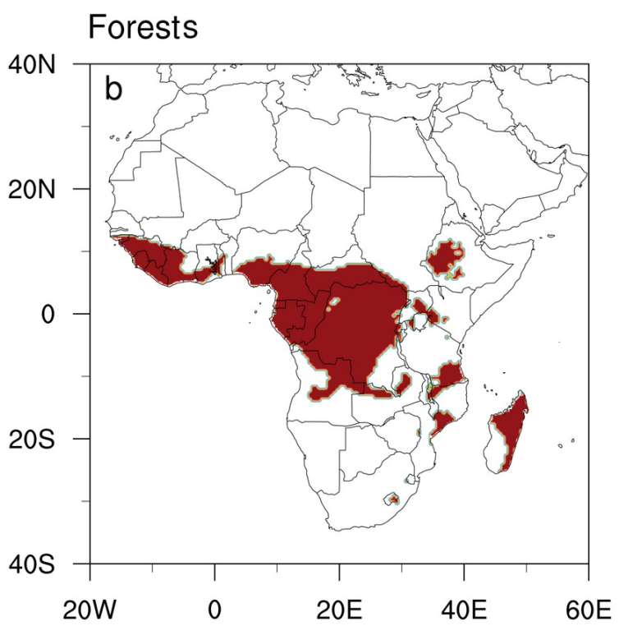
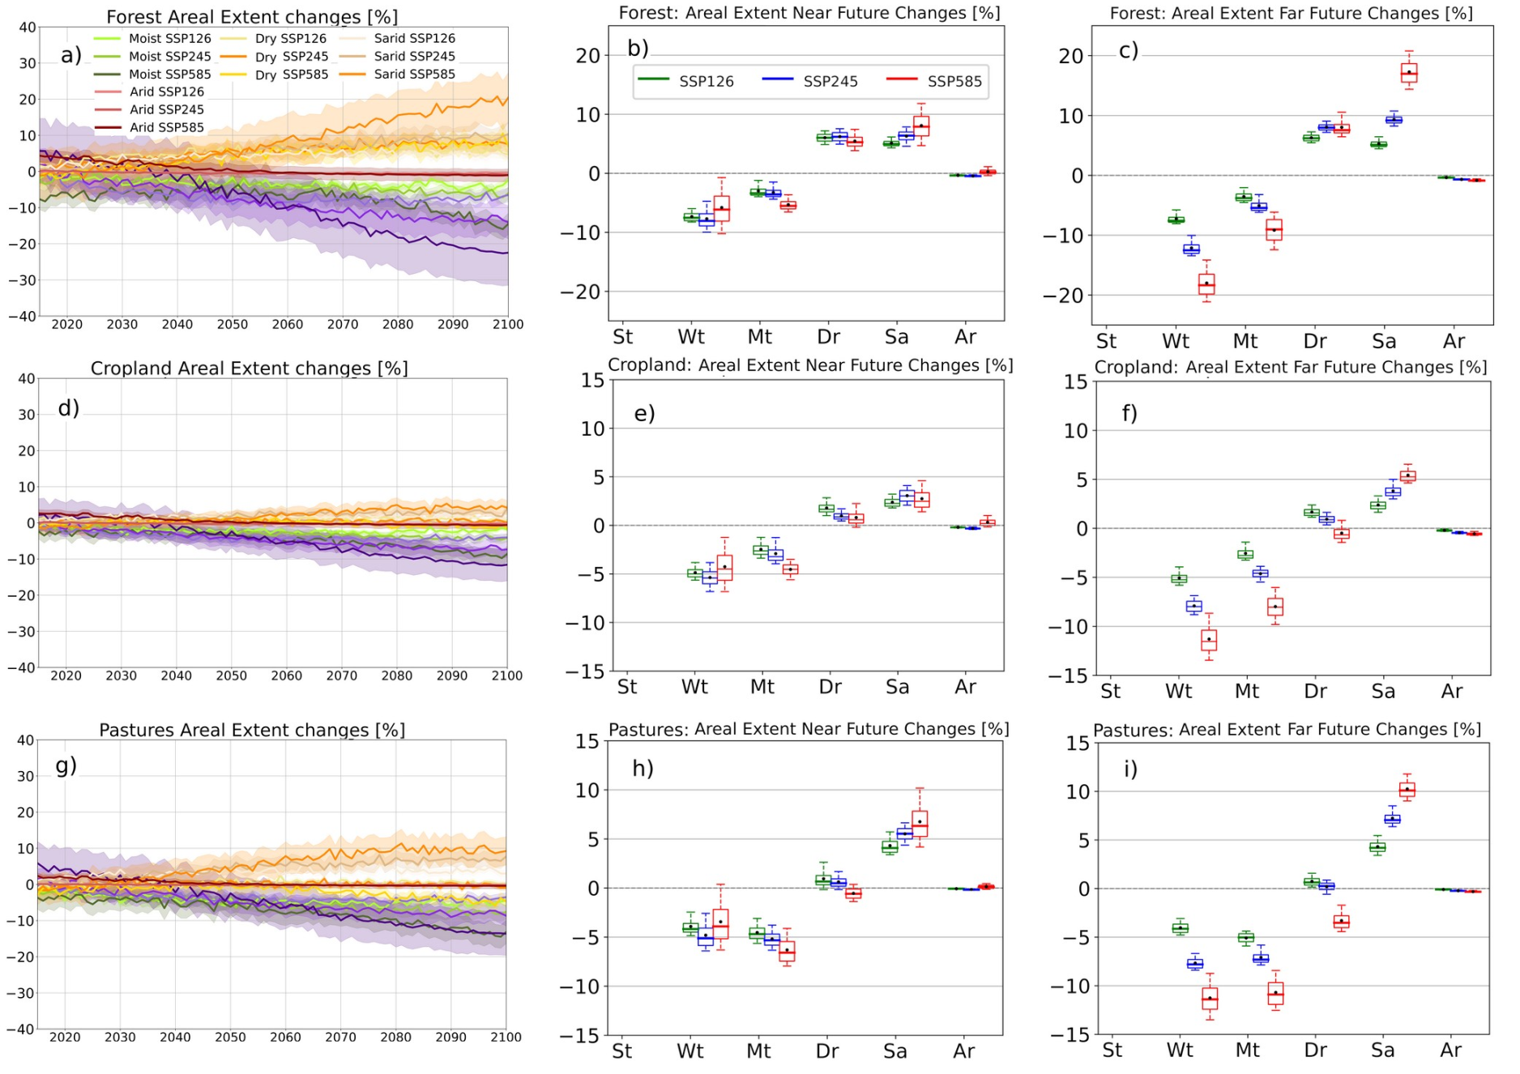
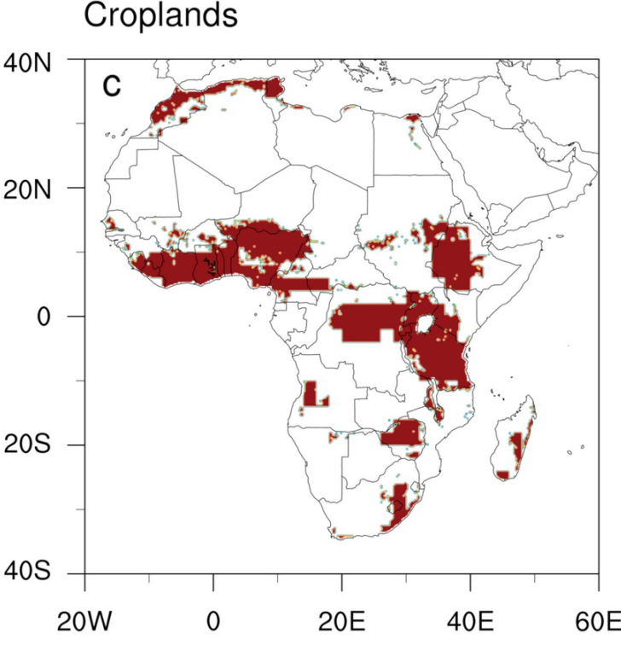
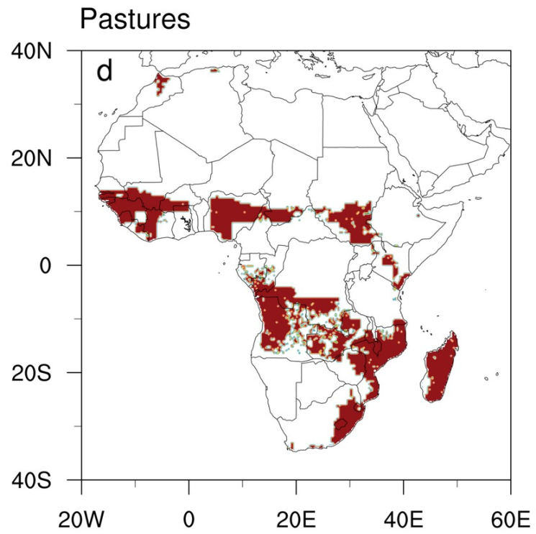
V/ Some gaps filled
Aridity: Projected exposure of biomes
Tall et al. 2023, Submitted

Slide 24
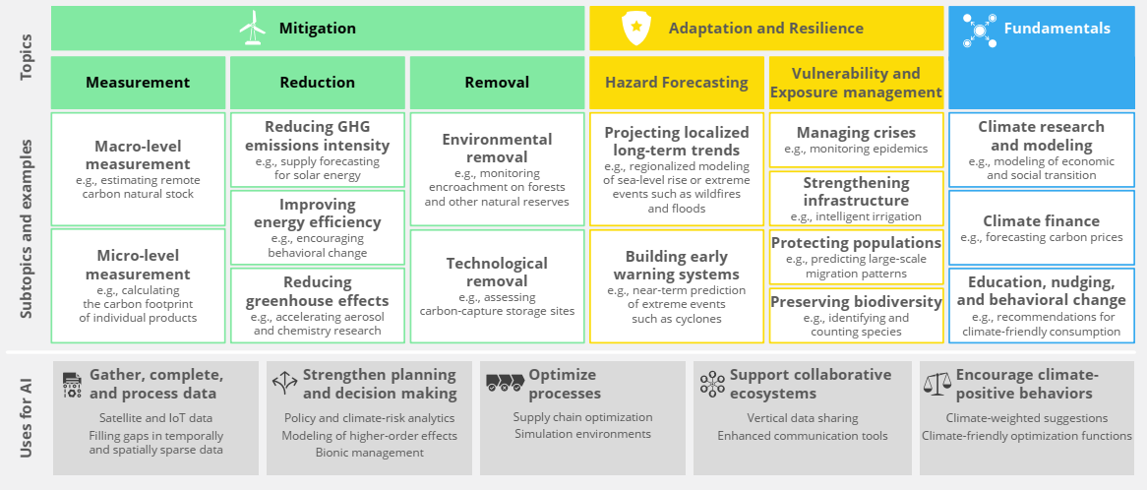
VI/ Looking into the future
Harnessing the power of AI/ML

Slide 25
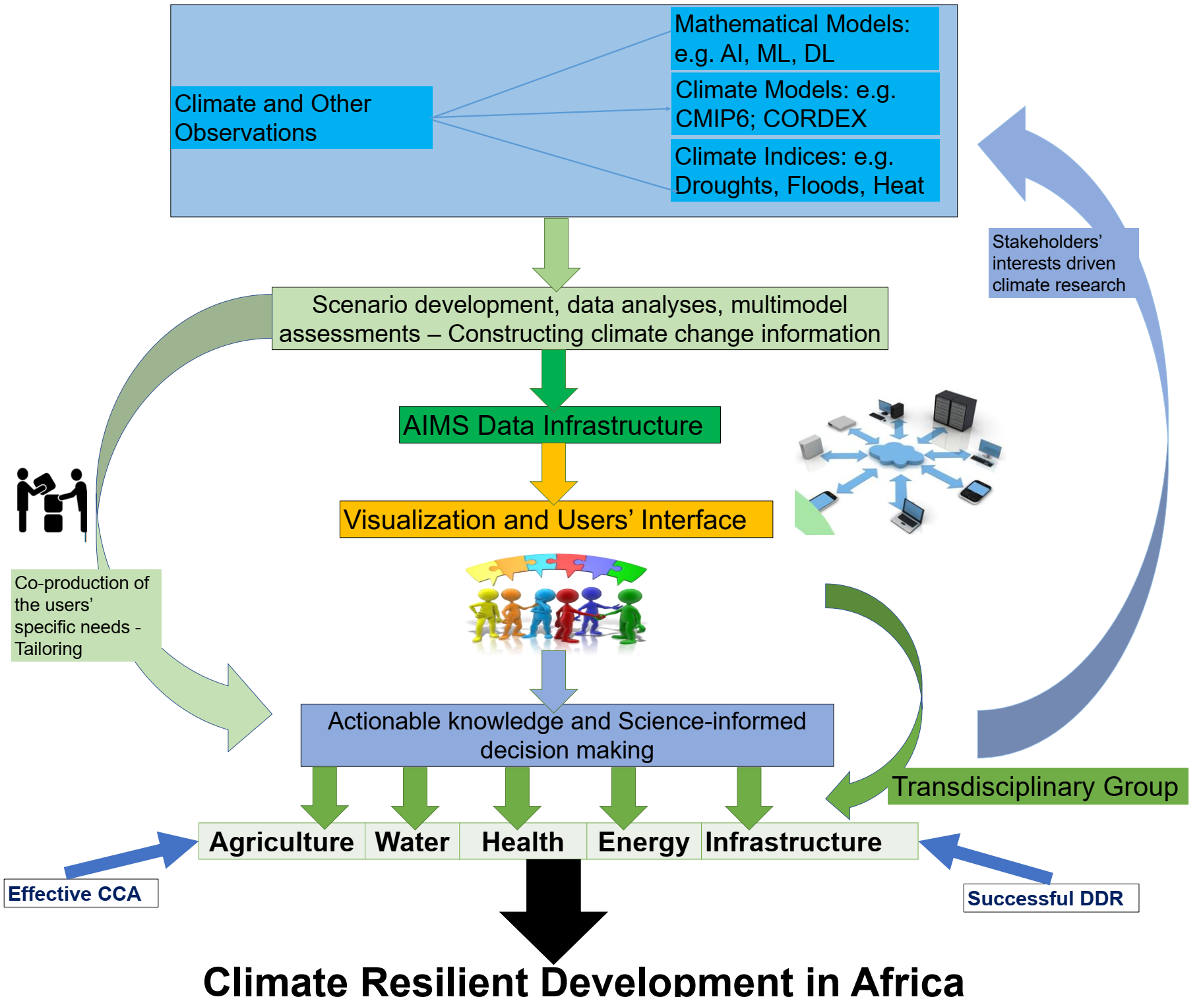
VI/ Looking into the future
Holistic CIS to support adaptation a different timescales

Slide 26
Thank you for your attention
Dr. Mouhamadou Bamba SYLLA (sylla.bamba@aims.ac.rw; syllabamba@yahoo.fr)
Research chair, African Institute for Mathematical Sciences (AIMS) - Rwanda
Lead Author of IPCC AR6, WG1: Chapter 12
Contributing Author to IPCC AR6, WG1: Chapter 11 and Atlas
Contributing Author to IPCC AR6 WG2: Chapter 9
Contributing Author to the IPCC SR1.5: Chapter 3

